Slide 1
Basic Design Structure
Lesson 1

Slide 2
Understanding flowcharts
Duration :3 Hours
Period : Week 2 Day 1

Slide 3
Learning Outcomes:
By the end of the lesson, students ,must be able to:
Define problem solving
Define an algorithm and explain what it is used for.
Identify inputs, processes and outputs needed to construct an algorithm.
Draw an IPO chart for a given problem.
Identify the algorithmic structures needed to produce a feasible algorithm to solve a given problem.
Recap
Notes:
Tip: Add your own speaker notes here.

Slide 4
Problem solving
People solve problems every time when they make decisions such as:
Should I watch the TV or go to the cinema?
What career do I want to follow?
Must I enroll for the coding bootcamp course or not?
Appropriate decisions determine direction of a person. Same applies in business, correct decisions saves companies money and bad decisions cost the company.
Notes:
When you get a problem to solve as a software developer, you have to consider a lot of things and take a lot of steps before implementing the solution. All the steps you take are part of problem solving.

Slide 5
Problem solving process
Step 1: Understand the problem
Step 2: Devise a plan to obtain possible solutions.
Step 3: Evaluate the solutions and choose the best one.
Step 4: Test the solution, resolve errors and apply the changes
Step 5: Implement the solution.
Notes:
Understand the problem-The first step to solving a problem involves understanding the problem and defining it. The best way to do this to break it into smaller manageable tasks. The first part involves writing down the problem and analyzing it. A good place to start your problem analysis is to investigate how the problem occurred. This is achieved through asking a lot of questions.
Devise a plan to obtain possible solutions.- Once you have completed your analysis of the problem you have to devise a solution. There are many techniques to help you to solve this. Such thinking processes include: Association (cause-effect-thinking). Analogy (comparisons), Brainstorming (group discussion), Intuition (knowledge and experience)Analytical thinking (dividing problem into smaller sub tasks).
Evaluate the solutions and choose the best one-Consider all possible solutions and identify weaknesses and strength of each problem. After eliminating all other solutions, go back to step 1 and see if your problem still exists.
Test the solution, resolve errors and apply the changes-Test the solution and test it. Ideal is to start with prototypes.
Implement the solution-This check for design flaws. A thorough test has to be implemented.

Slide 6
Common design techniques
Flowcharts
Algorithms
Pseudocodes
Storyboards
Wireframes e.t.c

Slide 7
What is a flowchart?
A flowchart is a problem-solving technique which uses diagrams to represent step by step solution.
Introduced in 1921 by Frank Gilbreth in a presentation called “Flow Process Chart”.
The process of drawing a flowchart for an algorithm is known as “flowcharting”.
Notes:
A flowchart is a method used to analyse a problem and then break it down into individual processes by representing the steps as boxes that are connected with arrows. This diagrammatic documentation gives a step by step solution to a problem

Slide 8
Flowcharts
A flowchart is a graphical representation of an algorithm.
Common Flowchart Symbols
 | Start or end of an algorithm
 | Process or computational operation
 | Input or out operation
 | Decision making operation
 | Direction of the flow of control
Notes:
The slide depict the common flowchart symbols that are used regularly.

Slide 9


Other Flowcharts symbols
 | Delay or Bottleneck
Off-Page Reference | It indicates that the flow continues on a matching symbol containing the same letter somewhere else on a different page.
Notes:
The slide depict the common flowchart symbols that are used regularly.

Slide 10
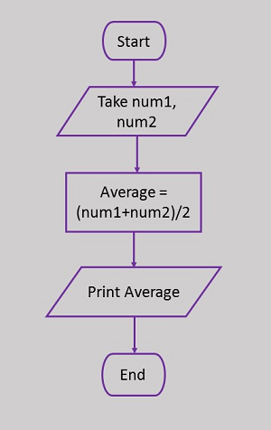
Adding two numbers
Identify the flowchart symbols used here.

Slide 11
Guidelines for creating flowcharts
Guidelines for Developing Flowcharts
These are some points to keep in mind while developing a flowchart −
Flowchart can have only one start and one stop symbol
On-page connectors are referenced using numbers
Off-page connectors are referenced using alphabets
General flow of processes is top to bottom or left to right
Arrows should not cross each other

Slide 12
Let us revisit some terms
Input- This is data captured from the keyboard or used as entry in the process. In most cases, you will see phrases such as accept, enter to signify input.
Process- this is what the program is supposed to do before displaying the result for instance add, calculate vat,
Output is the outcome of the program. In most cases you will see phrases like “display the ….”
Decision. This is mainly used whenever there is a condition where users can select options depending with what is available.

Slide 13
Let us consider the following problem
You are required to write a program to accept two numbers and compare them to display which one is greater. Before coding, a programmer must implement different design techniques such as flowchart, algorithm and many others. Use a flowchart to show how you would go about to solve the problem.

Slide 14
Flowchart Example
A flowchart that compares two numbers x and y:
Start
Input x
Input y
X > y?
No
Output y
Yes
Output x
Stop
Notes:
On the given diagram, note that the flowchart always begins with a start symbol. After the start, the designer made use of two parallelograms symbols depicting user input of the two numbers x and y.
After input, the next is a decision symbol. In some instances, others would see it as a process first and then add decision after. Depending with outcome the greater number is printed. However, the flowchart does not depict one possible solution which can result from the comparison. Which one is it.

Slide 15
Formative Task
Draw a flowchart to show the flow of logic and data for the following problem:
Develop a program to convert units of measure. The user will input kilograms and the program will output pounds. The formula for the conversion of kilograms to pounds is:
1 kg = 2.204623 pounds

Slide 16
Task 2
You have been asked by a client to write a program to accept integers between 5 and 20 until their sum is greater than 200.
Draw a flowchart to depict the scenario. Display how many were entered.

Slide 17
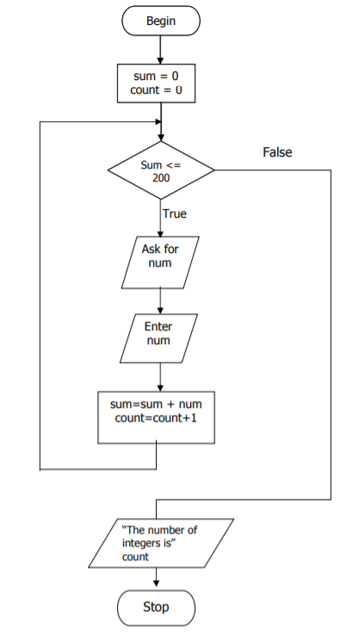
Task 2: Solution
Notes:
Take note that the program starts with initialization of sum and count variables. A variable is a space in the memory location whose contents may change.

Slide 18
Flowchart templates
Although you can start drawing flowcharts by scratch it is much easier to use templates. They help you reduce errors and reminds you about the best practices to follow.
Notes:
If you want to use a ready-made template, go to flowchart examples section and click on the flowchart that best suits you.

Slide 19
RECAP
What is a flowchart.
Is flowcharting really necessary in software development?
What are the guidelines for developing a flowchart?

Slide 20
Questions?
?

